Slide 1
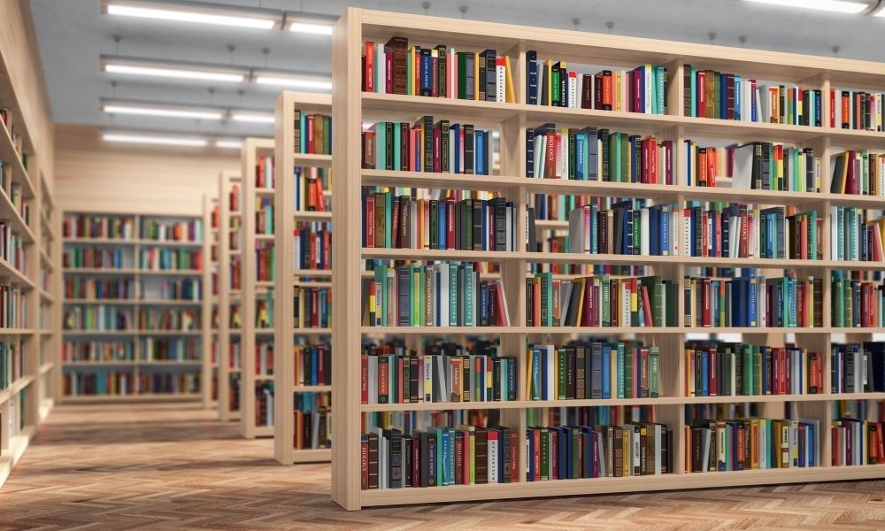


LIBRARY
MANAGEMENT
SYSTEM
Presented by:
Group 1 : Team 7
Gen 10

Slide 2
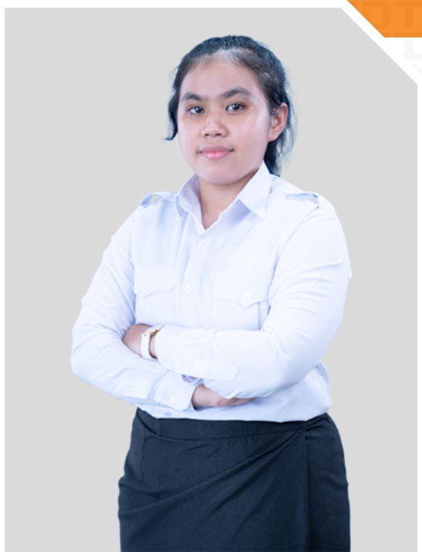
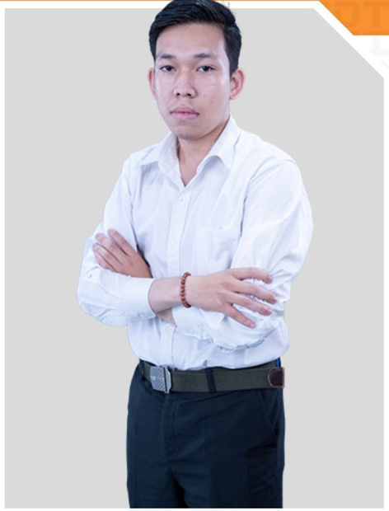
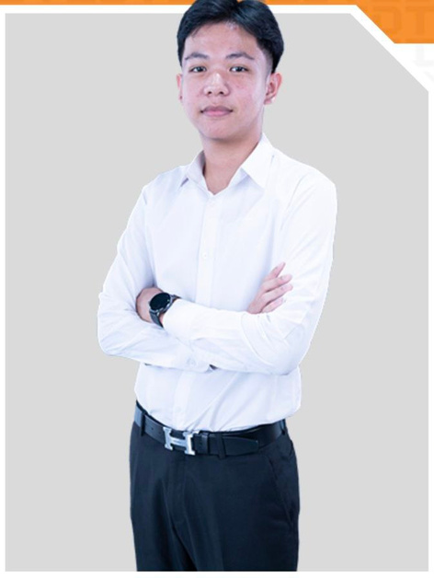
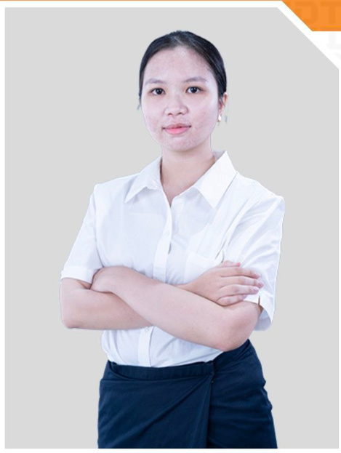
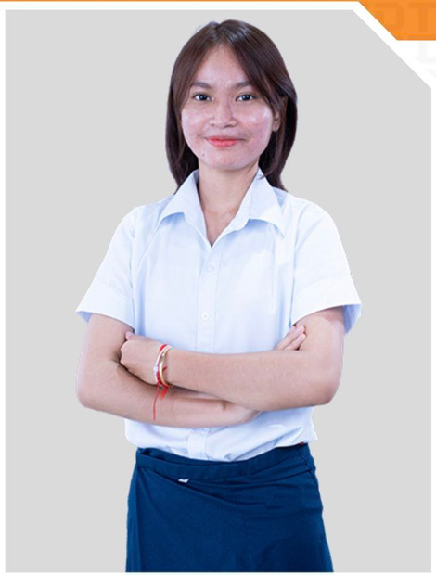
GROUP MEMBER
CHHAY LYMEAN
KHUN SOPHAVISNUKA
BOTH CHEALEAN
CHEA KOLTHIDA
EK SOPHEAKSETHEARINY

Slide 3


PURPOSE OF THIS PROJECT
The purpose of this project is for librarian to operate their library more easily with an effective way and this will let the student can borrow or view book more clearly without any problem.

Slide 4






CONTENS OF THIS PRESENTATION
BORROW
BOOK
STUDENT
DETAIL
VIEW BOOK
RETURN BOOK
ADDBOOK

Slide 5

VIEWING BOOK
The viewBook() function provides the ability to view the books based on user (librarian) to choose
There are 2 choice for user to search for a book
Which file does viewbook() function need ?
How does it work ?

Slide 6
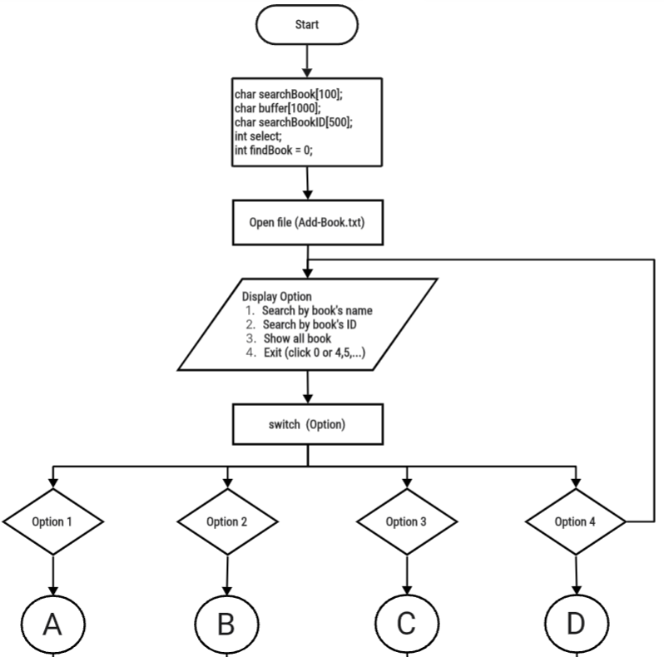
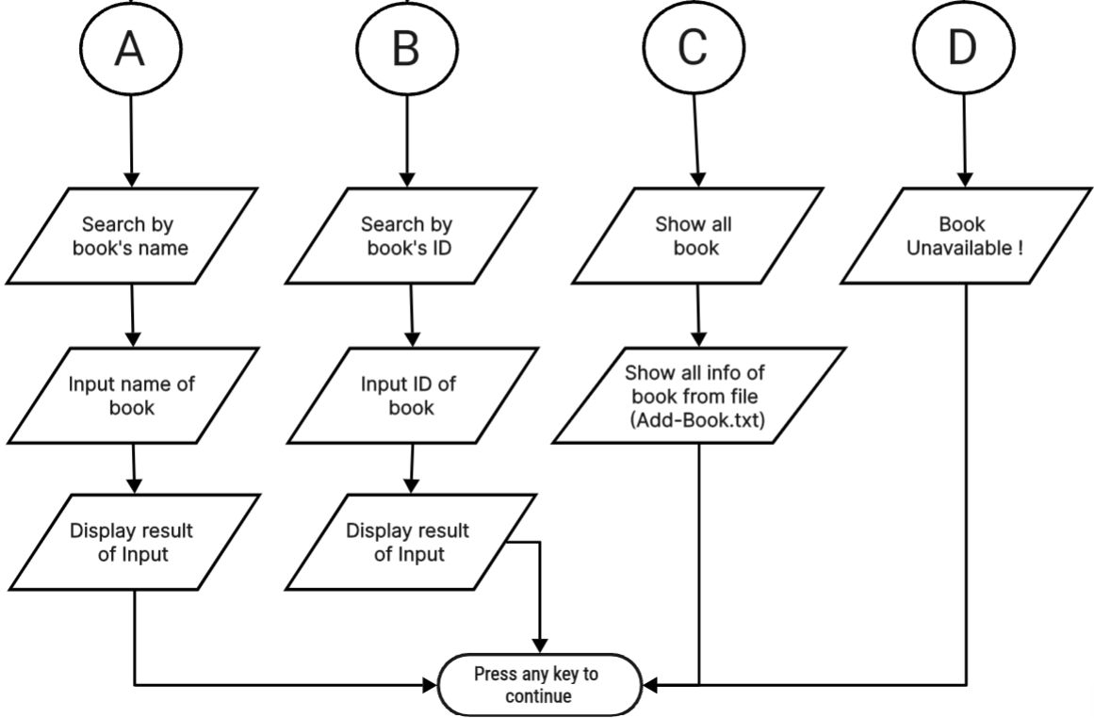
VIEWING BOOK
Invalid option

Slide 7

ADD BOOK
The addBook() function allows the librarian to add new books to the library's collection.
The information of book must be inputed by user(librarian).
Which file does addbook() function need ?
How does it work ?

Slide 8
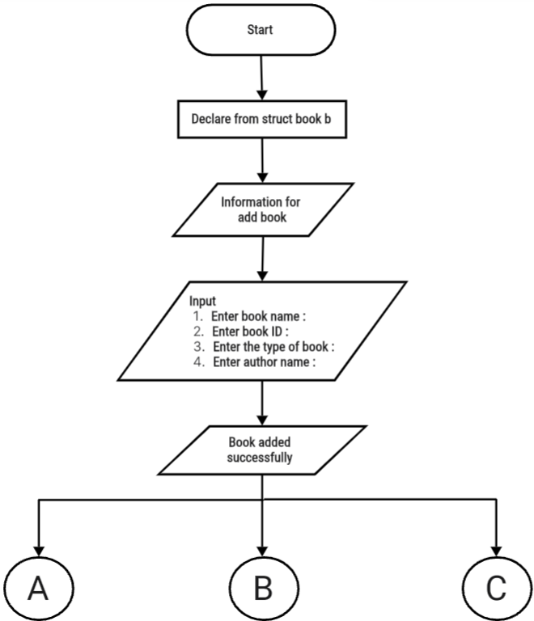
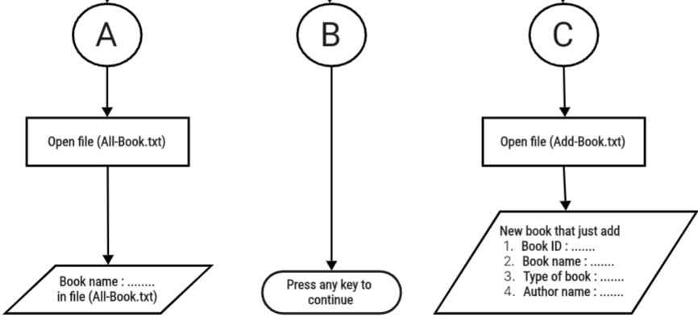
ADD BOOK

Slide 9


BORROW BOOK
The borrowbook() function allows user to borrow books from the library
The book must exist in the library first before being available to borrow
To borrow a book you need to input some information first such as your name, the date and phone number.
which file does the borrowbook() function need?
How does it work?

Slide 10
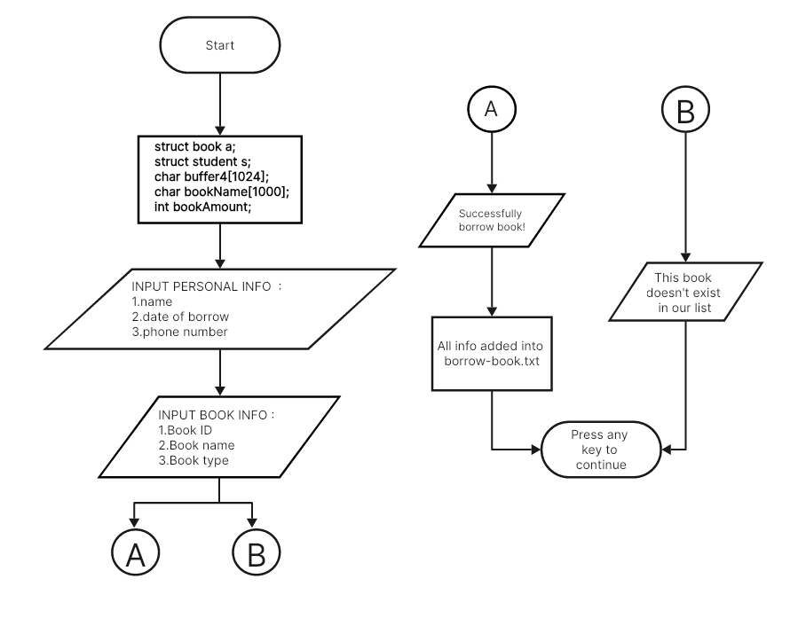
BORROW BOOK FLOWCHART

Slide 11


RETURN BOOK
The returnBook() function allows user to return the books back to the library.
There are three parts that user has to fill before returning books successfully, such as user’s name, book ID and book’s name.
Which file does returnbook() function need ?
How does it work ?

Slide 12
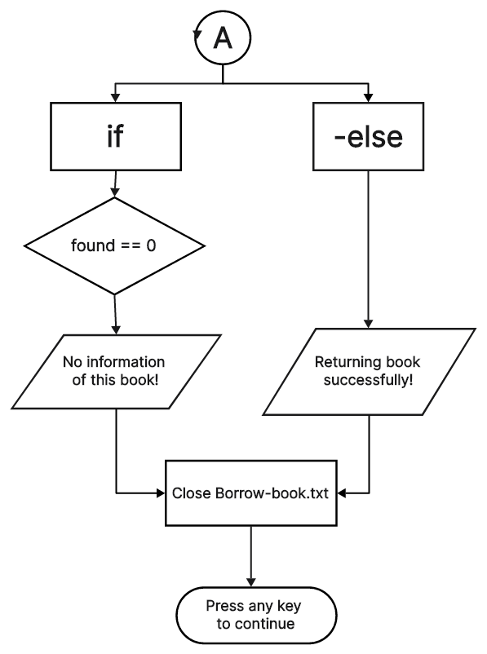
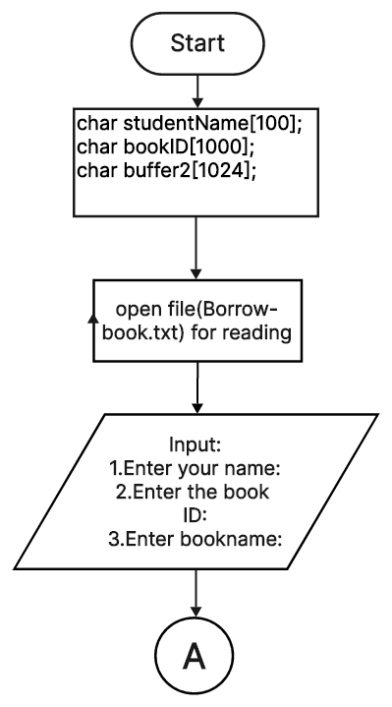


RETURN BOOK

Slide 13
STUDENT DETAIL
The Student-detail() function allows the librarian to view how many student borrow and who they are with clearly information .
There are only 2 choice for librarian to use in Student-detail() function .
Which file does Student-detail() function need ?
How does it work ?

Slide 14
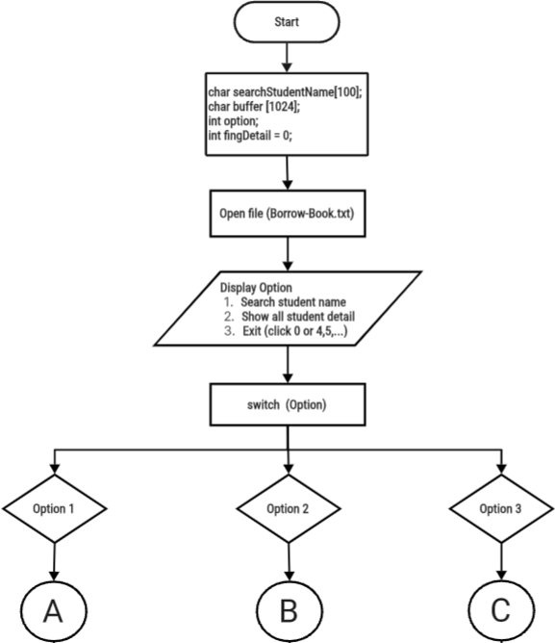
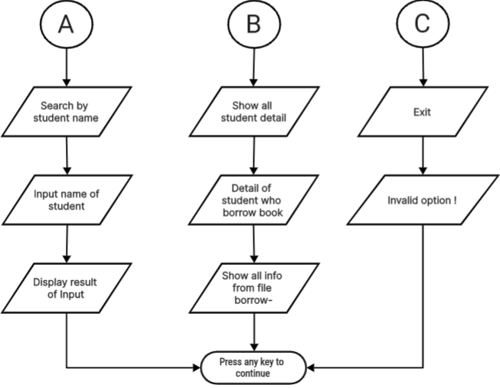
STUDENT DETAILS

Slide 15

Welcome to our project demo
Group 1 : Team 7
Gen 10

Slide 16
Thank you for
listening

